Slide 1
Comparative Evaluation of CAD Systems as Engineering Design Architectures
Katelynn Hughes, Emily Petty, Dr. Gregory Mocko
DISTRIBUTION STATEMENT A. Approved for public release; distribution is unlimited. OPSEC10927
Notes:
15 min presentation total + 5 min questions​
The evolution of CAD​
​

Slide 2
Acknowledgements
This work was supported by Clemson University’s Virtual Prototyping of Autonomy Enabled Ground Systems (VIPR-GS) under Cooperative Agreement W56HZV-21-2-0001 with the US Army DEVCOM Ground Vehicle Systems Center (GVSC).
Disclaimer: Reference herein to any specific commercial company, product, process, or service by trade name, trademark, manufacturer, or otherwise, does not necessarily constitute or imply its endorsement, recommendation, or favoring by the United States Government or the Department of the Army (DoA). The opinions of the authors expressed herein do not necessarily state or reflect those of the United States Government or the DoA and shall not be used for advertising or product endorsement purposes.
Notes:
To begin with, I would like to acknowledge our project sponsors, Clemson’s VIPR-GS center and the US Army DEVCOM ground vehicles systems center​
I would also like to clarify that the services discussed in this presentation are not endorsed by Clemson University, The US Army, or the US Government​
Next slide​

Slide 3
“Asynchronous collaboration is an inevitable part of the global workforce. However, there is a gap in asynchronous collaborative research and solutions that integrates diverse groups engaged in a shared objective.”¹
Maj. Domoniqué Hittner, ASA(ALT)
¹D. Hittner. “The Design and Development of a Defense Acquisition Workforce Virtual Environments for Asynchronous Collaboration (VEAC).” Twentieth Annual Acquisition Research Symposium. 2023
Notes:
Due to this research gap, we are looking at asynchronous collaboration through an engineering geometry and CAD systems perspective.

Slide 4
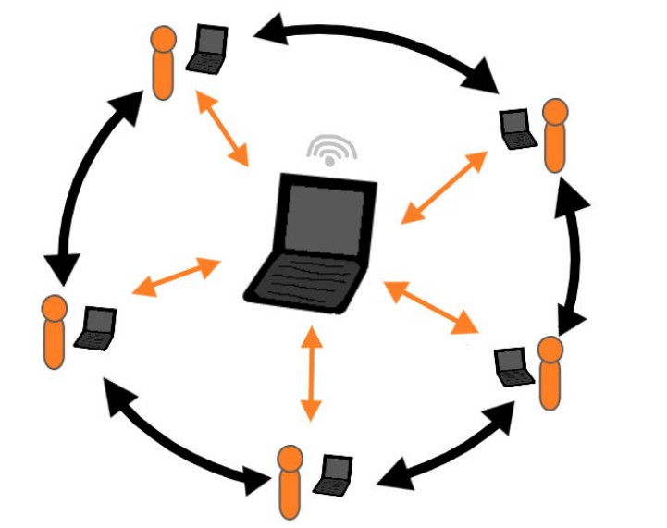
Background
Globally dispersed teams introduce challenges with collaboration²
        Sharing
        Security
        Versioning
        License management
        Reviewing designs
Cloud tools can be used to collaborate concurrently
Cloud CAD systems are relatively new, and don’t solve every challenge
²E. Petty, N. Edmonds, G. Mocko, and E. Patterson. “Collaborative CAD in Support of Engineering Design Reviews.” International Design Engineering Technical Conferences & Computers and Information in Engineering Conference (IDETC-CIE). 2024
Notes:
Asynchronous collaboration is primarily an issue for globally dispersed teams, where they face challenges such as those listed here.
While cloud tools within CAD systems have the capability to address some of these challenges, no program can accomplish every issue on its own without the inclusion of a third-party tool.
In order to properly understand how CAD systems inhibit or enable collaboration, we have compared the collaborative capabilities of CAD systems

Slide 5
Overview of CAD Architectures
Traditional CAD Architecture
Cloud-Enabled CAD Architecture
Cloud-Native CAD Architecture
Notes:
In order to provide a holistic evaluation of the CAD architecture instead of comparing individual CAD systems, we have sorted each CAD system into one of three architectures depending on their degree of cloud integration.
Traditional CAD systems are single-user systems that have no cloud infrastructure. This is the system that many engineers are initially trained on, as universities don’t often teach students how to use CAD systems in a virtually collaborative manner.
Cloud-enabled CAD systems have integrated PLM tools into their systems, so users are able to access a shared cloud server native to the CAD system. These systems often utilize check-in/check-out models, which restrict the ability for multiple users to access the same file simultaneously, and are often built off traditional CAD systems or combining a traditional CAD system with a plugin.
Cloud native systems are inherently designs for multi-user collaboration and online functionality. In a sense, this makes these systems similar to GitHub for CAD. They offer browser-based features, so users can edit and access models on any device type.

Slide 6
Evaluation Procedure
35 requirements³
3 CAD systems per architecture
CAD systems evaluated qualitatively with a Likert scale
Two evaluation methods: user interaction and advertised information
Annotations
Concurrency
Heterogeneity
IP Protection
Security
Version Control
Viewing
³E. Petty, “Cloud-Native MUCAD for Design Reviews.” MS Thesis, Clemson University. 2025
Notes:
Each CAD architecture was evaluated against 35 requirements related to performing a virtual design review within a CAD system to evaluate how well systems can assist in non-local collaboration. Each requirement falls within one or more of these seven categories, related to the topics the requirement focused on.

Slide 7
Evaluation Procedure
35 requirements³
3 CAD systems per architecture
CAD systems evaluated qualitatively with a Likert scale
Two evaluation methods: user interaction and advertised information
Traditional CAD Architecture
SolidWorks
Siemens NX
Autodesk Inventor
Cloud-Enabled CAD Architecture
Siemens NX + Teamcenter
SolidWorks PDM
Creo+
Cloud-Native CAD Architecture
OnShape
Autodesk Fusion
Siemens Solid Edge
³E. Petty, “Cloud-Native MUCAD for Design Reviews.” MS Thesis, Clemson University. 2025
Notes:
To get a holistic view of the CAD architecture itself, 3 CAD systems were selected to be representative software for each architecture.
This is so that the evaluation stays focused on the virtual collaborative limits imposed by the cloud integration, not individual system distinctions
It can be noted that there are 4 CAD vendors represented here, with each having at least two CAD systems evaluated in different architecture. This allows for themes to be identified when comparing systems with lower levels of cloud integration to those with higher cloud integration.

Slide 8
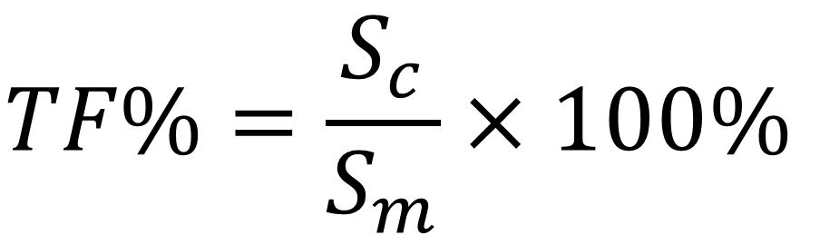
Evaluation Procedure
35 requirements³
3 CAD systems per architecture
CAD systems evaluated qualitatively with a Likert scale
Two evaluation methods: user interaction and advertised information
Fulfillment Category | Score
Not Met | 0
Partially Met | 1
Mostly Met | 2
Fully Met | 3
$$TF\%=\frac{S_{c}}{S_{m}}×100\%$$
³E. Petty, “Cloud-Native MUCAD for Design Reviews.” MS Thesis, Clemson University. 2025
Notes:
The CAD systems were evaluated against a qualitative likert scale, based on the degree in which the CAD system met each requirement
The score corresponding to the scale was used to calculate the total fulfillment for each requirement category,
where the total fulfillment is a percentage comparing a CAD system’s score within that category compared to the maximum possible score
An example of the likert scale can be used with requirement 19, “The system shall enable all operations to be undoable”
A CAD system that has not met this requirement has the complete inability to undo actions. A partially met system has the ability to only undo operations within an active session. A system that mostly met this requirement has the ability to revert versions and undo operations, but only in an active setting. A system that fully met this requirement has the ability to fully undo any action, within or outside of the active session
Requirement 19. “The system shall enable all operations to be undoable.”
Partially Fulfilled: “Operations can only be undone within an active session”
Mostly Fulfilled: “Operations can undo operations within an active session and can revert to previous versions but cannot undo between sessions.”

Slide 9
Evaluation Procedure
35 requirements³
3 CAD systems per architecture
CAD systems evaluated qualitatively with a Likert scale
Two evaluation methods: user interaction and advertised information
³E. Petty, “Cloud-Native MUCAD for Design Reviews.” MS Thesis, Clemson University. 2025
Notes:
Each cad system was evaluated through user information and/or advertised information
User information corresponds to using the architecture and evaluating it manually whereas advertised information means assuming the system performance based on published material from the developers, user guides, and product information

Slide 10
Comparative Metrics
Intra-Architecture
Inter-Architecture
Traditional CAD Architecture Performance
SolidWorks
Siemens NX
Autodesk Inventor
CAD Architecture Performance
Traditional CAD Architecture
Cloud-Enabled CAD Architecture
Cloud-Native CAD Architecture
Notes:
CAD systems were compared both within the architecture to evaluate certain themes within the architecture and to get a holistic view of the architecture, and between architectures to see how the degree in which cloud tools are integrated effects the collaborative ability of users

Slide 11
Performance Within Traditional CAD Architecture
Poor fulfillment scores
  Maximum of 7 fully met requirements for all CAD systems
Struggled within all requirement categories other than Heterogeneity
Category | SolidWorks | Siemens NX | Inventor | Average
Annotations | 26 | 26 | 30 | 27
Concurrency | 21 | 21 | 21 | 21
Heterogeneity | 67 | 78 | 67 | 70
IP Protection | 0 | 0 | 0 | 0
Security | 0 | 0 | 0 | 0
Version Control | 37 | 37 | 40 | 38
Viewing | 14 | 14 | 14 | 14
Notes:
The results are expected, as traditional CAD systems are single-user systems.
Therefore requirements based on concurrent work would have low fulfillment
The heterogeneity category deals with data transfer between platforms, which is not limited to synchronous work
It can be noted that none of the systems fulfilled any of the Security or IP Protection categories.
This is due to those requirements dealing with access permissions for parts—something that is not needed for a system that is intended to have one user
Clarify that these are percentages

Slide 12
Performance Within Cloud-Enabled CAD Architecture
CAD systems had at most requirements met to at least a partial degree
Most CAD systems struggled in the Viewing category
CAD systems fully met all Security and nearly all IP Protection requirements
Category | NX + Teamcenter | SolidWorks PDM | Creo+ | Average
Annotations | 70 | 74 | 85 | 77
Concurrency | 67 | 61 | 97 | 75
Heterogeneity | 67 | 78 | 67 | 70
IP Protection | 94 | 94 | 100 | 96
Security | 100 | 100 | 100 | 100
Version Control | 83 | 87 | 93 | 88
Viewing | 48 | 38 | 76 | 54
Notes:
Compared to the traditional CAD, where each system had a minimum of 23 unfulfilled requirements, the maximum amount of not fulfilled requirements in the cloud-enabled category was 4
All three systems fully fulfilled every requirement in the security category and nearly all of the IP protection ones
This is something that is to be expected, as privacy vulnerabilities are a large concern for cloud systems
The features put into place for security and IP protection allow designers to prevent work from being stolen
This category had the most varied results—but this can be explained by the nature of the architecture
Many cloud-enabled cad systems are built by adding cloud features to existing traditional CAD systems.
This creates variation between how developers go about making a system collaborative—such as when choosing between concurrent editing or check-in/out models

Slide 13
Performance Within Cloud-Native CAD Architecture
Each CAD system had at least half of the requirements fully met
  Only one CAD system had requirements that were not met to any degree
At least 2/3 of the CAD systems fully met all of the requirements in the Heterogeneity, IP Protection, and Security categories
Category | OnShape | Fusion | Solid Edge | Average
Annotations | 93 | 81 | 93 | 89
Concurrency | 94 | 94 | 79 | 89
Heterogeneity | 100 | 100 | 100 | 100
IP Protection | 100 | 94 | 100 | 98
Security | 100 | 100 | 67 | 89
Version Control | 100 | 97 | 87 | 94
Viewing | 90 | 81 | 71 | 81
Notes:
The lower performing systems were evaluated through advertised information—which could have had an impact on the score
Even so, the lowest score in each category were comparatively better than cloud-enabled or traditional systems
Compared to the cloud-enabled cad architecture, cloud-native systems had an average of 28.33 fully fulfilled requirements compared to 21.33

Slide 14
Comparison of Architectures
Best Performance by Category
Issues with each Architecture
Category | Best Performing Architecture | Total Fulfillment of Category
Annotations | Cloud-Native | 89%
Concurrency | Cloud-Native | 89%
Heterogeneity | Cloud-Native | 100%
IP Protection | Cloud-Enabled | 100%
Security | Cloud-Enabled | 100%
Version Control | Cloud-Native | 94%
Viewing | Cloud-Native | 89%
Traditional
  Lack of multi-user capabilities
  Security protections are on local drives only
  Software is OS-dependent
Cloud-Enabled
  Check-in and check-out models inhibit real-time collaboration
  Software is OS-dependent
Cloud-Native
  Lack of strong simulation capabilities
Notes:
While inherently, cloud-native systems may seem best on paper, each CAD architectural type has its use in industry and reasons as to why engineers would choose one system over another
The lack of any multi-user capabilities within TC systems does prevent any cloud collaboration, but many engineering students are trained on these systems, and many smaller engineering firms use these systems due to their lower licensing costs
Additionally, many cloud-enabled CAD systems are built off of traditional CAD systems, which allows engineers trained on traditional CAD systems to switch to these systems easier than a cloud-native system that they have not used before
The performance of systems represents how the way we teach engineers CAD needs to include more focus on virtual collaboration in order for designers to reduce the effect of the inherent challenges of non-local collaboration

Slide 15
Limitations
CAD systems are unable to be fully evaluated without user interaction
Study does not focus on designer preference for single- or multi-user CAD systems
Study does not include how users interact within the different architectures
A limited number of CAD systems were evaluated

Slide 16
Key Insights
MUCAD capabilities can foster collaboration
There is room for improvement within CAD systems in all architectures to improve collaboration
Traditional CAD systems struggled against the collaborative requirements
Cloud-enabled and cloud-native CAD systems performed better against the requirements, but no CAD system was able to fully meet all requirements

